Slide 1

Enhancing Stock Market Prediction Using Multimodal Deep Learning and Explainable AI
Internal Guide : Ms. Soume Sanyal
Team No: C14
Students: Anish Grandhe – 1602-22-737-133
Karthik Peetela – 1602-22-737-317

Slide 2

Problem Statement
Predicting the stock market is one of the most demanding tasks in financial analytics due to the constant fluctuations and influence of a wide variety of factors. Standard models struggle to make sense of diverse data like prices, trading volumes, and external news events, which all interact to affect asset values.
Furthermore, existing approaches are often opaque, unable to show why a particular prediction was made or how the system responded to new information. This lack of clarity and adaptability makes it difficult for investors and regulators to trust or audit these models.

Slide 3

Motivation
A truly effective prediction system could help investors anticipate major market moves, minimize risks, and respond more intelligently to ongoing changes. Such a tool would transform strategy and decision-making at all levels, from individual traders to regulatory authorities.
Despite powerful advances in artificial intelligence, there is still no widely deployed solution that can blend heterogeneous data sources, adapt to new markets, and produce transparent forecasts. Solving these challenges would mean a major leap forward for both financial research and real-world investment practice.

Slide 4
Literature Survey
Citation | Key Contributions | Relevance | Limitation and Gaps
Long et al. (2024) | Multi-view multi-kernel SVM combining market and news data for SSE 50; daily returns prediction improves accuracy over simple fusion. | Demonstrates the power of integrating heterogeneous data sources for financial forecasting. | Linear kernel restricts adaptability; framework not tested for regime shifts or new markets.
Alam et al. (2024) | Robust hybrid LSTM-DNN on 26 real-life datasets enhances stability and prediction accuracy for multiple companies. | Provides a benchmark for deep hybrid architectures on diverse financial datasets. | Generalization limited—performance drops on unseen stocks or in changing market conditions.
Gao et al. (2022) | Integrates sentiment from multiple news sources using RNN ensemble optimized by genetic algorithm; effective in US indices. | Shows improved sentiment fusion’s value for index trend prediction. | No support for real-time, adaptive learning; limited cross-market validation.
Luo et al. (2024) | Applies CNN-BiLSTM with attention for better short-term correlation forecasting; highlights key temporal features. | Validates the benefit of attention mechanisms for financial time-series interpretability. | Largely relies on single-modal data; lacks full-scale multimodal fusion.
Goswami et al. (2024) | Combines engineered features with hybrid LSTM-dense layers for nonlinear market patterns in NIFTY, S&P, Nikkei. | Illustrates the potential of feature-rich models for broad market prediction. | Susceptible to overfitting and lacks systematic interpretability features.

Slide 5

Justification and Significance
The proposed research is justified by the persistent limitations in existing stock market prediction models, which often fail to integrate the varied influences of market data and external information such as news sentiment. By developing a framework that can systematically fuse heterogeneous data streams, this work addresses a core gap in financial machine learning and sets the foundation for more accurate and context-aware predictions.​
Significantly, the model advances the field by prioritizing interpretability and transparency, making each prediction explainable and accountable—qualities crucial for investor trust and regulatory compliance. Its enhanced ability to generalize across different markets and adapt to new situations ensures practical value in real-world trading environments. By establishing rigorous benchmarking and open evalution practices, this work aims to set new standards for fairness, reproducibility, and ethical deployment in financial AI.

Slide 6
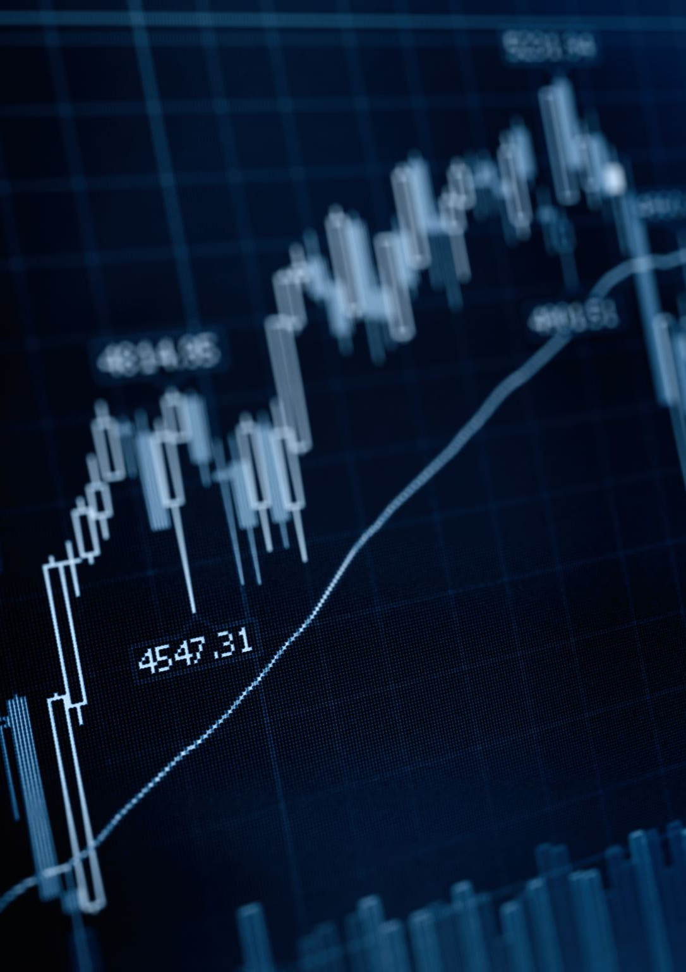
Research Gaps Stock Market
Despite advances in deep learning, key gaps remain. Current models lack effective integration of heterogeneous data, limiting their predictive power. Many operate as black boxes with poor interpretability. They often fail to generalize across different markets or adapt to new financial environments. Ethical considerations and benchmarking standards are seldom addressed, restricting real-world trust and adoption.
Addressing these gaps is vital for progressing from theoretical models to practical, transparent, and reliable stock market forecasting tools.

Slide 7
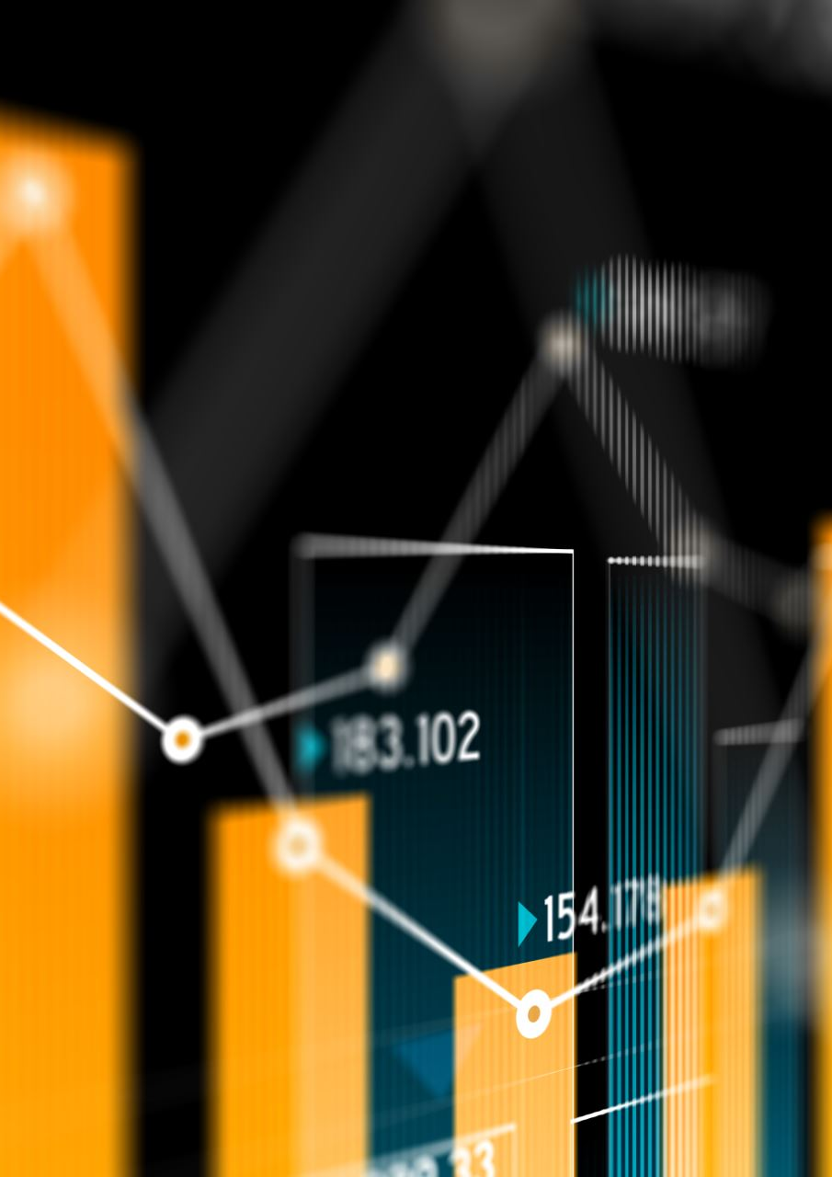
Outline of Proposed Solution
Objective 1: Design a multimodal data integration pipeline that collects, preprocesses, and fuses stock prices, technical indicators, and news sentiment, enabling comprehensive feature extraction for robust prediction.
Objective 2: Develop a hybrid neural network model—combining CNN, BiLSTM, and attention layers—that adaptively captures short-term and long-term market trends, learns from diverse data, and produces transparent, interpretable predictions.
Objective 3: Implement built-in benchmarking, explainability, and compliance modules to assess model performance across multiple markets while supporting fairness audits and regulatory reporting.

Slide 8
Dataset Plan
Historical stock data and technical indicators will be sourced from public APIs (such as Yahoo Finance and Alpha Vantage) for leading indices and major stocks. News sentiment data will be accessed using free or academic-access news APIs.
The plan is to synchronize all datasets by trading date, preprocess them for missing values and outliers, and merge into a unified format suitable for time-series analysis and model training. This approach ensures diverse, high-quality data for robust model development and evaluation.

Slide 9
Implementation Tools
Python: Primary programming language for data handling, modeling, and scripting.
TensorFlow/PyTorch: Deep learning libraries used for building, training, and evaluating the hybrid model.
Pandas and NumPy: For efficient data preprocessing, transformation, and analysis.
Yahoo Finance and NewsAPI: For collecting historical stock data and real-time/news sentiment data.
Matplotlib/Plotly/SHAP: For visualizing model predictions and interpreting feature importance and attention weights.

Slide 10
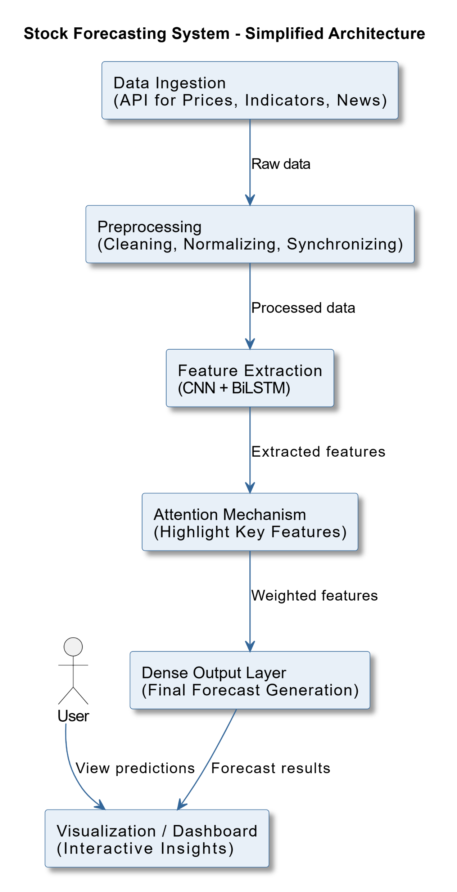
Architecture Diagram

Slide 11
THANK YOU

